Slide 1

Artistic Expressions with Generative AI
Suryatapa Roy
Data Scientist, Chata AI

Slide 2

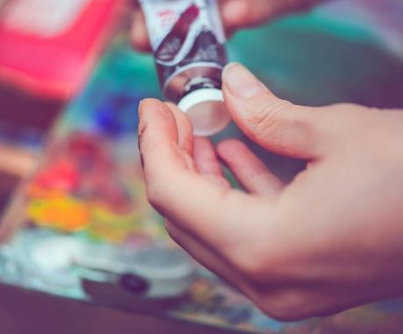
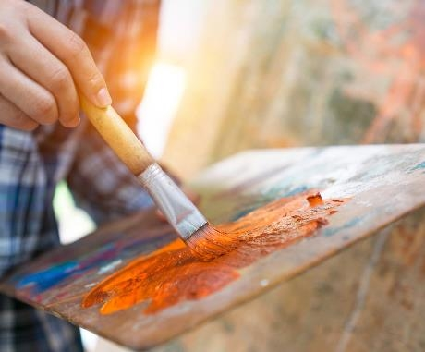
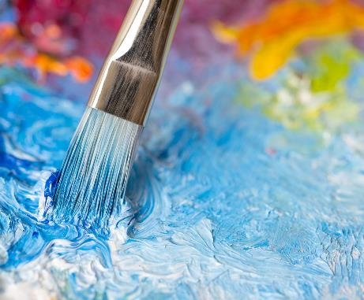
Agenda
Generative AI - Overview
Model Architectures – Vision
Model Architectures – Audio
Tools & APIs
Demos

Slide 3
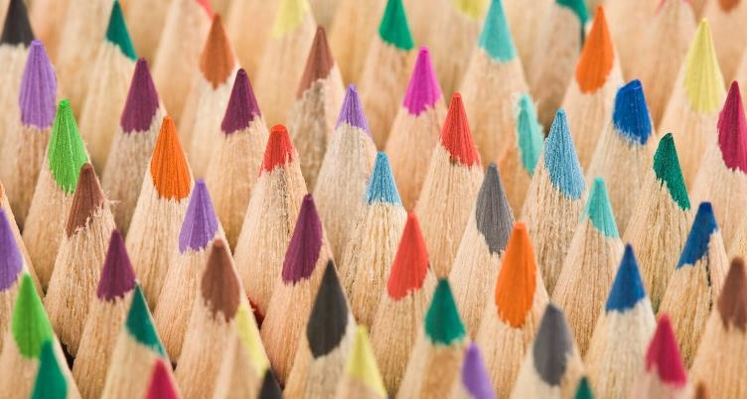
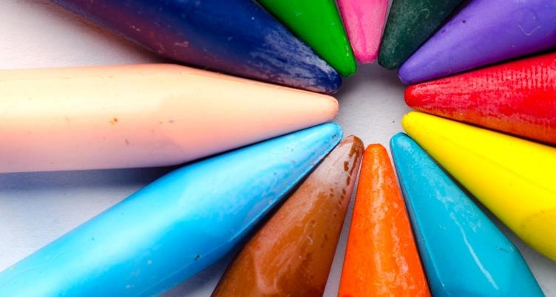
Generative AI
Overview

Slide 4
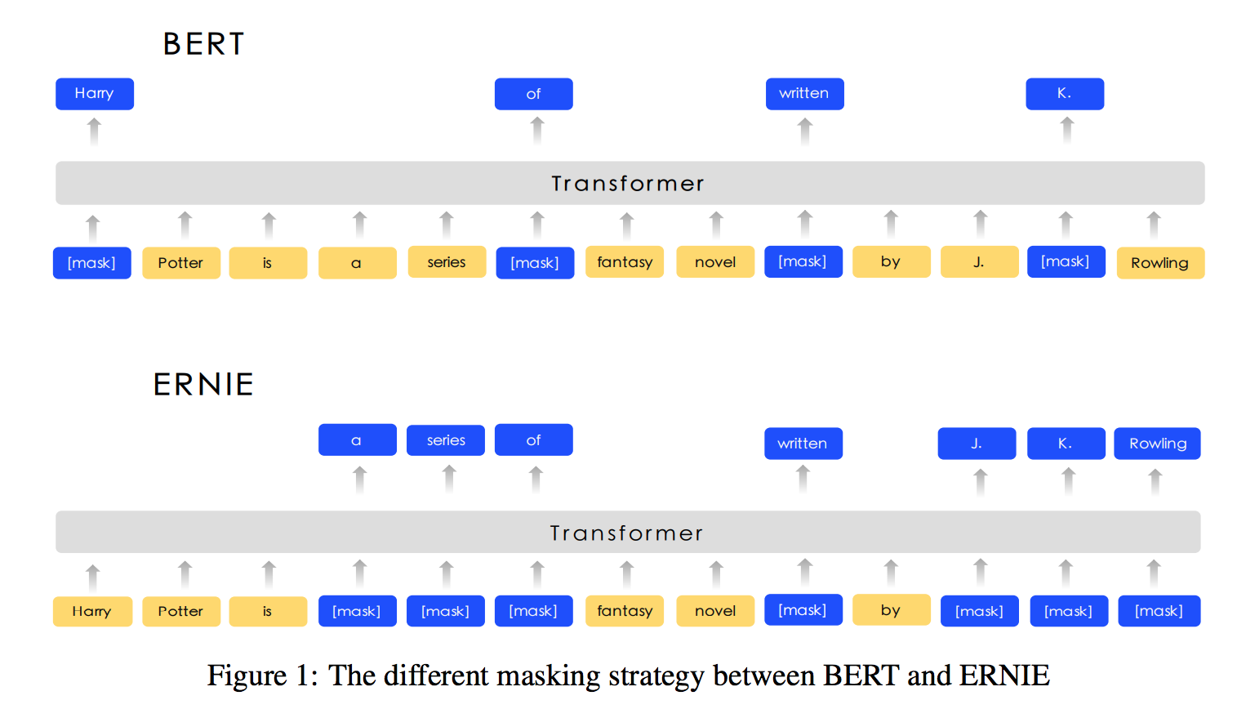
Self Supervised Learning - Pretraining
Self Supervised Learning
https://bangliu.github.io/survey/2019/07/01/NLP-Pretraining/

Slide 5
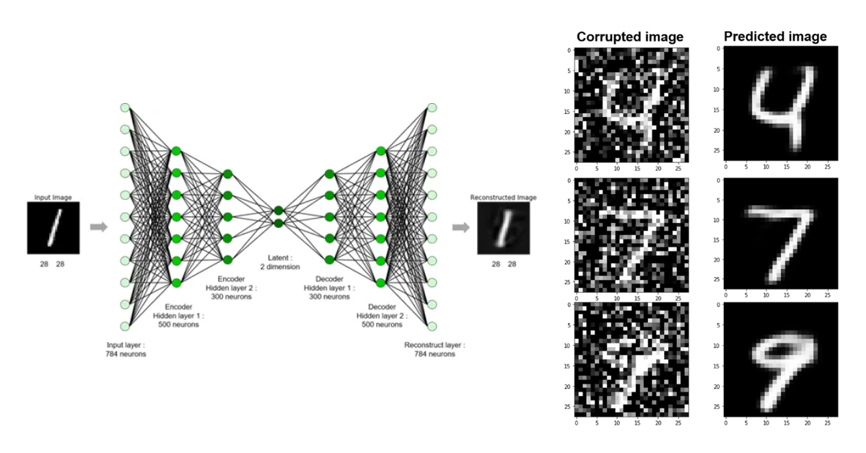
Denoising - AutoEncoding
https://omdena.com/blog/denoising-autoencoders/

Slide 6
Model Architectures
Vision

Slide 7
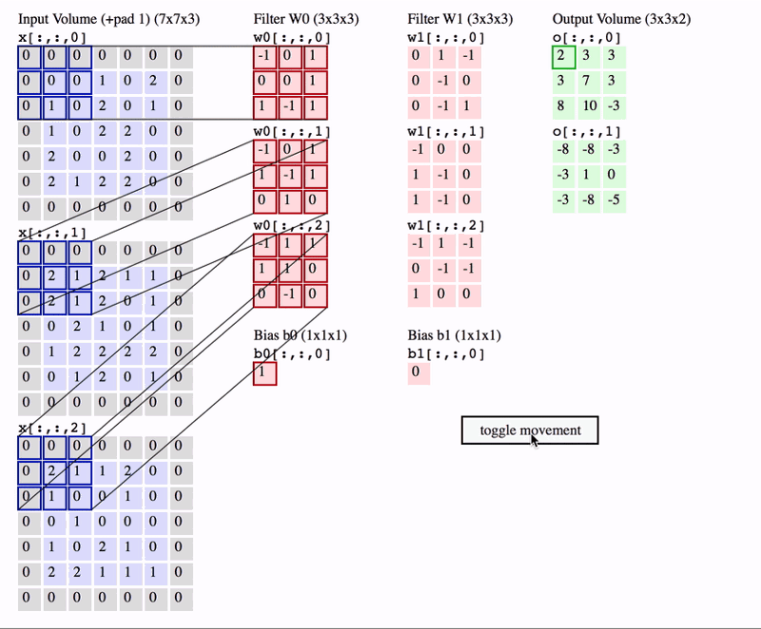
Convolutional Neural Network
https://towardsdatascience.com/pytorch-basics-how-to-train-your-neural-net-intro-to-cnn-26a14c2ea29

Slide 8

Vision Transformers
https://www.v7labs.com/blog/vision-transformer-guide

Slide 9
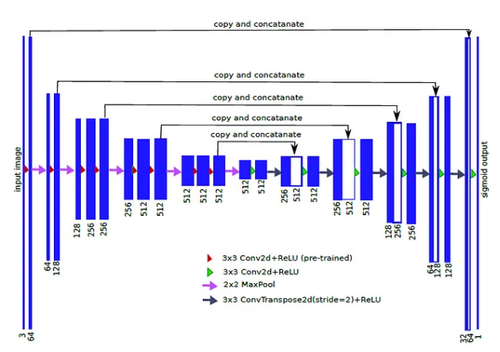
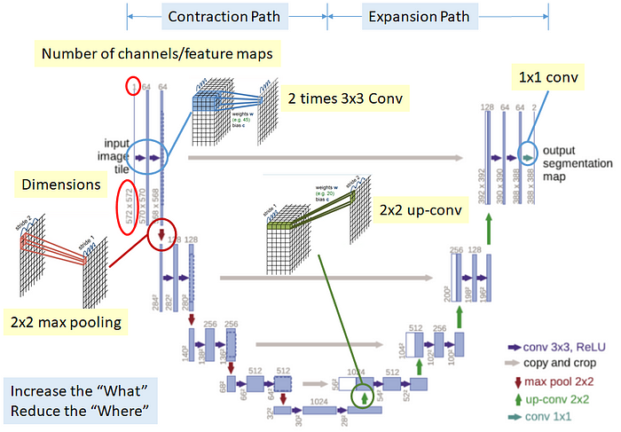
U-Net
https://towardsdatascience.com/review-u-net-biomedical-image-segmentation-d02bf06ca760
https://sh-tsang.medium.com/brief-review-ternausnet-u-net-with-vgg11-encoder-pre-trained-on-imagenet-for-image-segmentation-2f6b461596d9

Slide 10
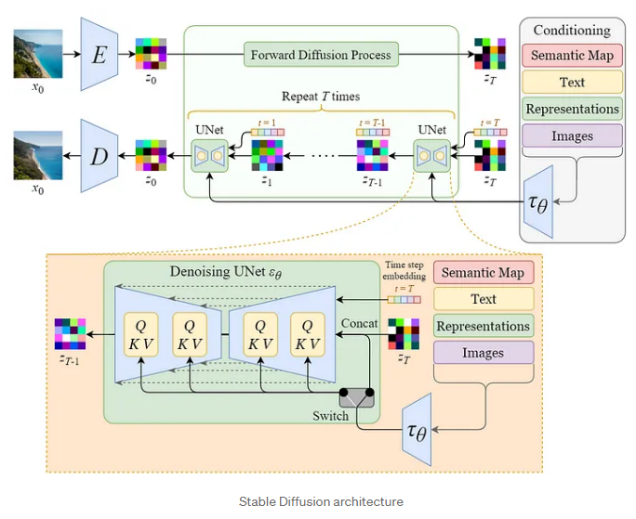
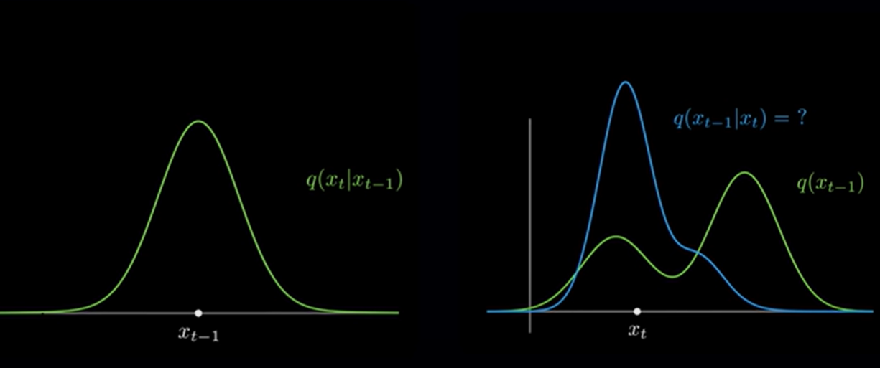
Diffusion Models
https://lilianweng.github.io/posts/2021-07-11-diffusion-models/
https://medium.com/@steinsfu/stable-diffusion-clearly-explained-ed008044e07e

Slide 11
Model Architectures
Audio

Slide 12
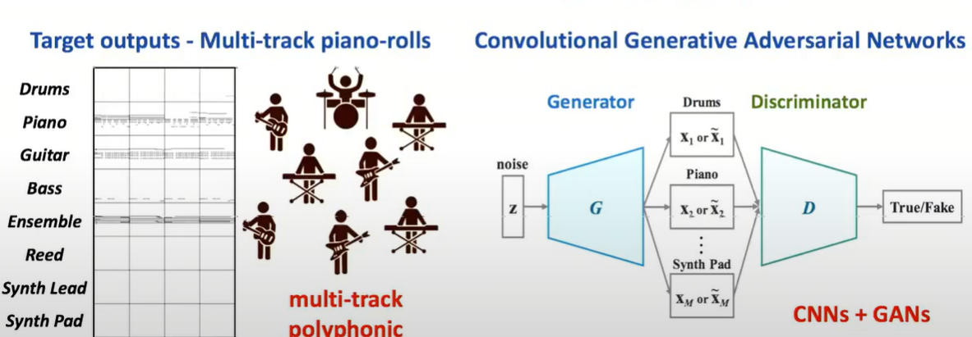
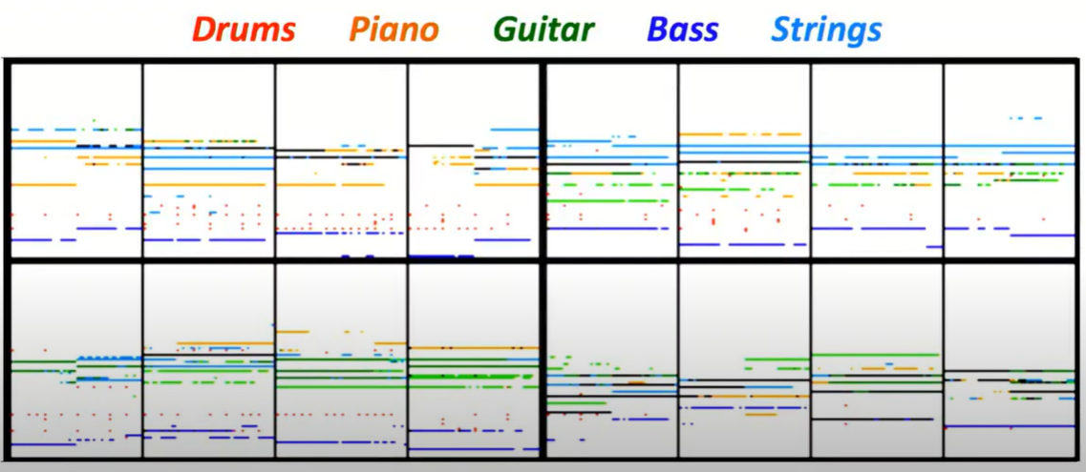
MuseGAN
https://www.youtube.com/watch?v=r9C2Q2oR9Ik

Slide 13
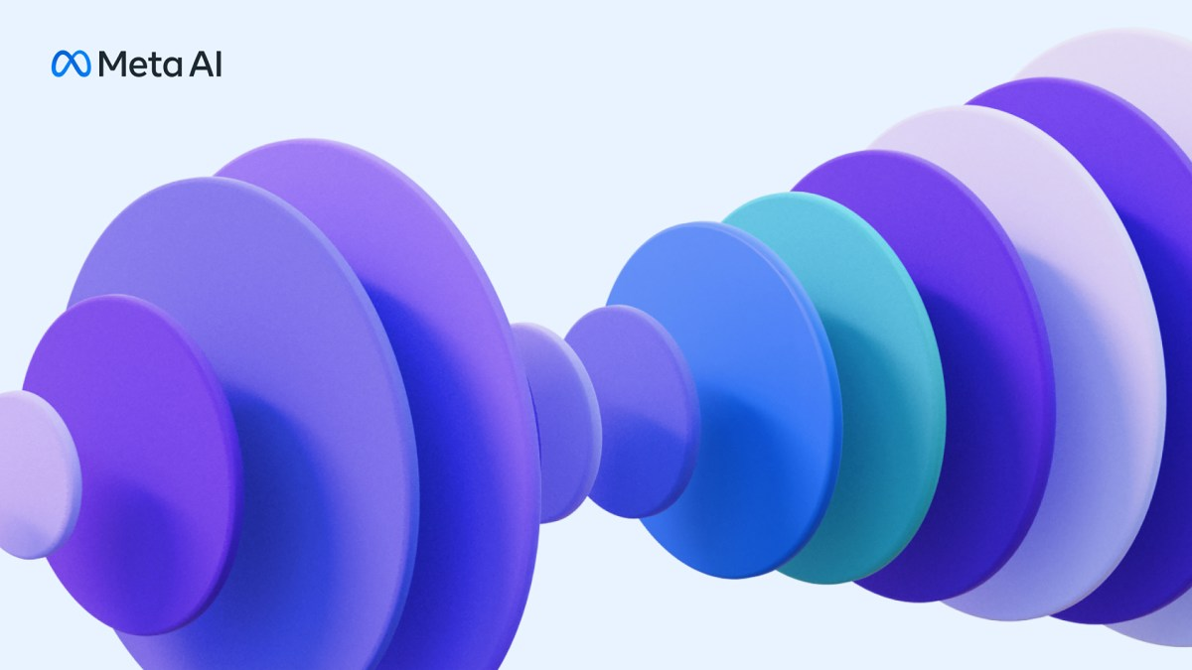
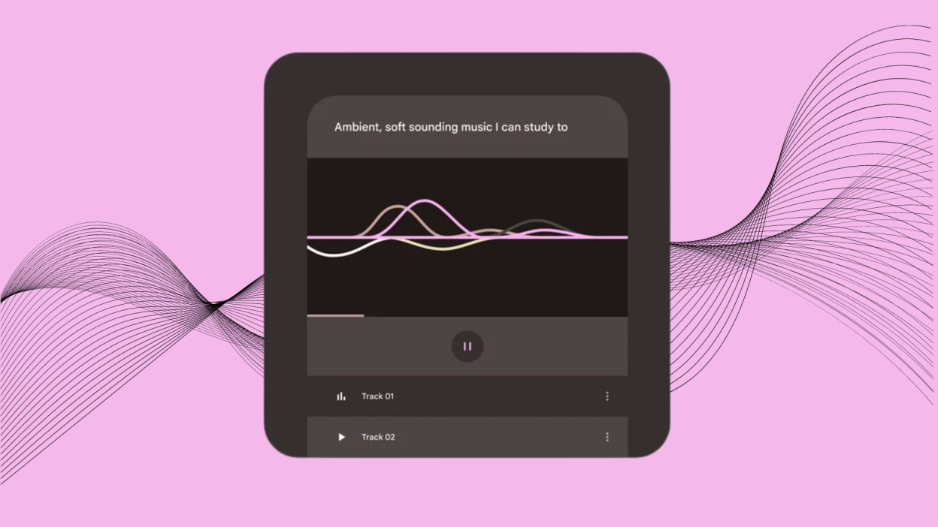
AudioCraft & MusicLM
https://github.com/riffusion/riffusion https://github.com/facebookresearch/audiocraft
https://github.com/archinetai/audio-diffusion-pytorch https://github.com/lucidrains/musiclm-pytorch

Slide 14
Generative AI
Tools & APIs

Slide 15
Resources
Game Development:
https://holovolo.tv/home
https://www.youtube.com/watch?v=bX4iGFzfdDg
https://github.com/dobrado76/Stable-Diffusion-Unity-Integration
https://www.youtube.com/watch?v=8gf5GPzhgk8
APIs & App Development:
https://docs.astria.ai/docs/category/use-cases
https://github.com/comfyanonymous/ComfyUI
https://streamlit.io/
https://www.gradio.app/
Learning:
https://www.youtube.com/watch?v=fbLgFrlTnGU

Slide 16
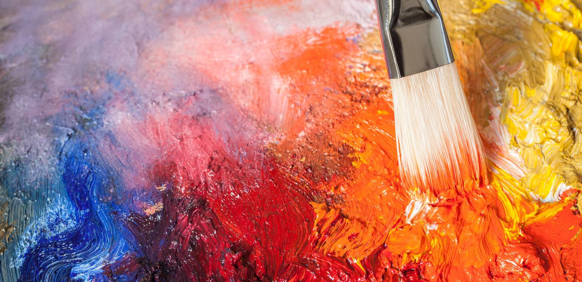
Demos

Slide 17
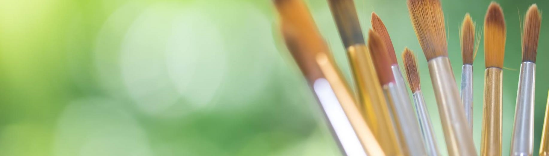
Thank you
Suryatapa Roy
sroy@chata.ai

